Slide 1
UNIT 11
Residuals / Model Assessment / Simple Linear Regression / Coefficient Interpretation after Log Transformation

Slide 2
Assumptions for Simple Linear Regression
Linearity
A straight line may be inadequate.
Outliers may bias estimates.
Constant Variance (Equal Spread)
Estimates (Betas) are still unbiased.
Standard Errors are inaccurate, thus rendering tests and confidence intervals to be misleading.
Normality
Both the estimates and their standard errors are robust to non-normal distributions.
Similar to hypothesis testing, problems arise with long tails (outliers) and small sample sizes.
Violations will affect prediction intervals more than confidence intervals.
Independence
Lack of independence causes no bias in the estimates, although seriously affects standard errors. Need for more sophisticated models … NEXT SEMESTER!!!

Slide 3
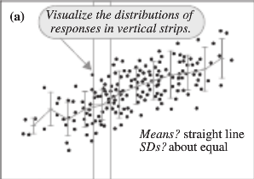
Model Assessment (Graphical)

Slide 4
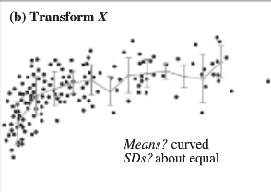
Model Assessment (Graphical)

Slide 5
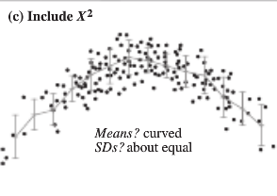
Model Assessment (Graphical)

Slide 6
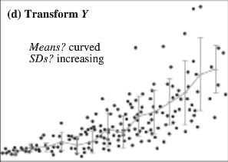
Model Assessment (Graphical)

Slide 7
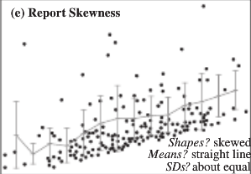
Model Assessment (Graphical)

Slide 8
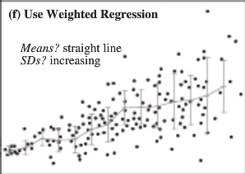
Model Assessment (Graphical)

Slide 9
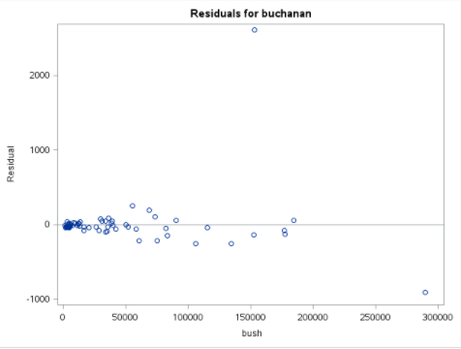
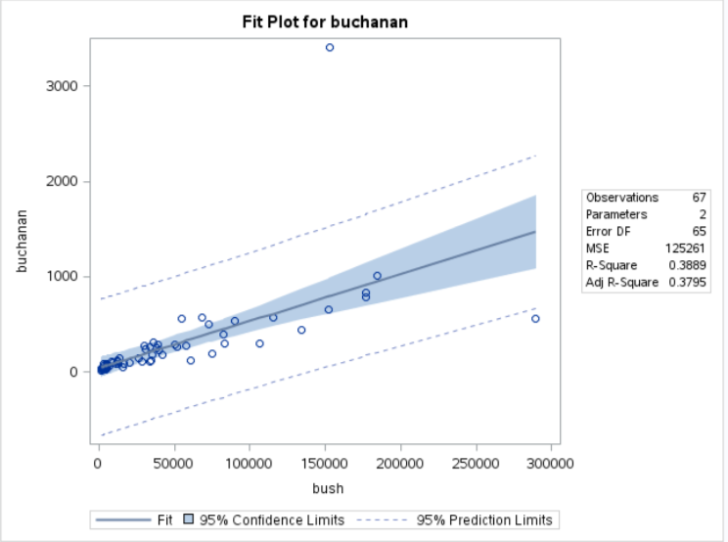


Scatterplot of Residuals
Removing (subtracting) the mean often reveals/highlights any non-linearity, non-constant variance, and/or outliers.
Remember:
Residual = Observed - Expected
$${res}_{i}=Y_{i}−{\hat{Y}}_{i}$$
$${res}_{i}=Y_{i}−({\hat{β}}_{0}+{\hat{β}}_{1}X_{i})$$

Slide 10
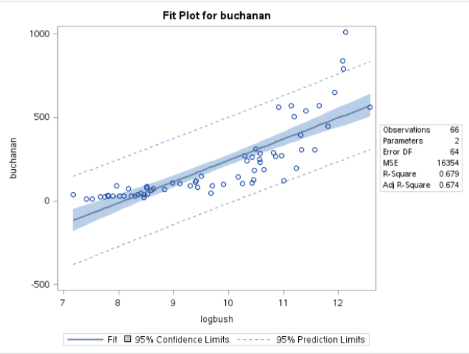
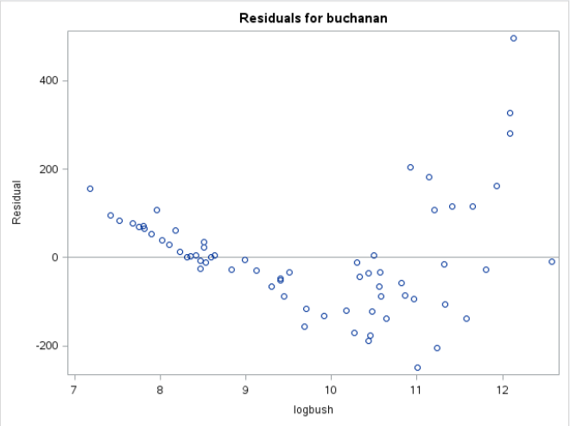
Residual Analysis
Curvature means non-random cloud: non-constant variance, non-linearity

Slide 11
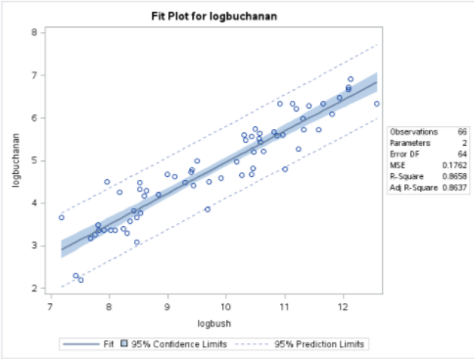
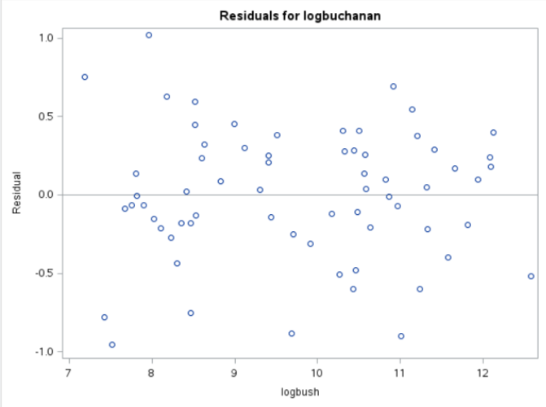
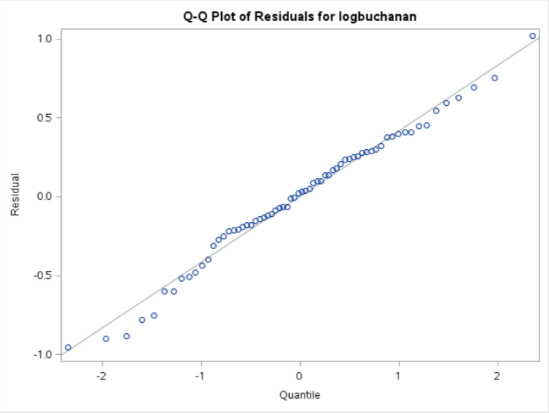



Checking Assumptions with Residuals
$$Y_{i}= β_{0}+β_{1}X_{1_{i}}+ε_{i}$$
If the assumptions are met, then:
$$ε_{i}\sim N(0,σ^{2})$$
${Each ε}_{i}$ (error) can be estimated with the residual of observation i (e_{i})!
$$Y_{i}= {\hat{β}}_{0}+{\hat{β}}_{1}X_{1_{i}}+e_{i}$$
Even scatter … linear trend … no curvature
Also .. Equal SD.
Residuals are normally distributed.
Linear

Slide 12
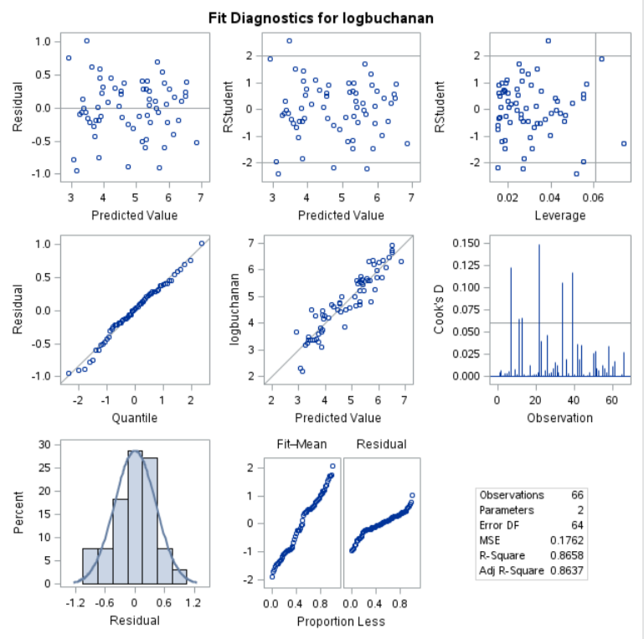


The Regression Panel

Slide 13
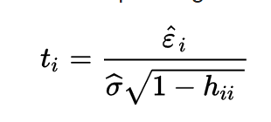
The Regression Panel
These are studentized residuals, which are essentially the residual divided by the standard deviation of the observation. We know that the residuals are assumed to be normally distributed; thus, for now, it is enough to know that observations with a studentized residual greater than 2 or less than -2 may be flagged as extreme values. Below is the formula for the studentized residual. We will study this much more in a future section.
Here, h_{ii} is the “leverage” of the i^{th} observation. We will discuss “leverage” later.

Slide 14
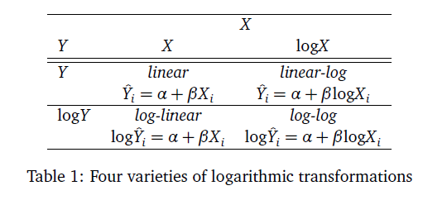
Log Transform

Slide 15

Insulation and Voltage Data
Time | Voltage
5.79 | 26
1579.52 | 26
2323.7 | 26
68.85 | 28
108.29 | 28
110.29 | 28
426.07 | 28
1067.6 | 28
7.74 | 30
17.05 | 30
20.46 | 30
21.02 | 30
22.66 | 30
43.4 | 30
47.3 | 30
139.07 | 30
144.12 | 30
175.88 | 30
194.9 | 30
In an industrial laboratory, under uniform conditions, batches of electrical insulating fluid were subjected to constant voltages until the insulating property of the fluids broke down. Seven different voltage levels, spaced 2 kilovolts apart from 26 to 38 kV were studied. The measured responses were the times, in minutes, until breakdown.
n = 76

Slide 16
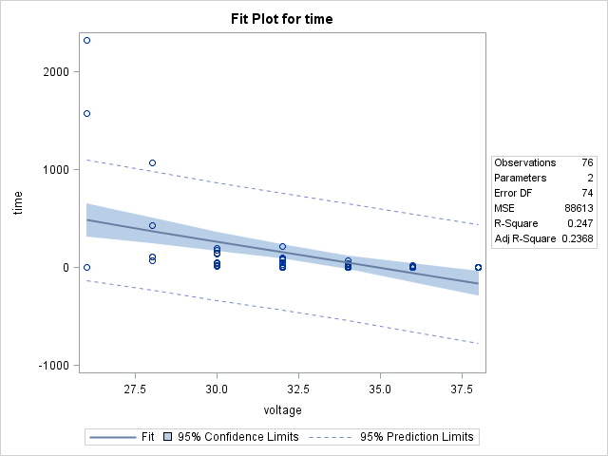
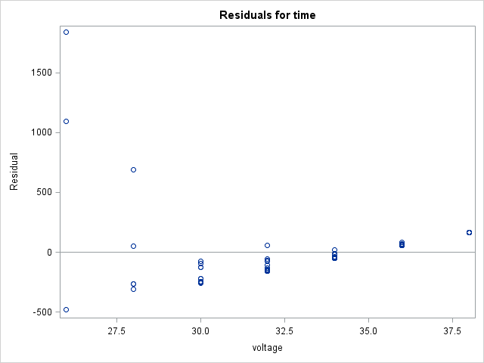
Insulation v. Voltage
Definite curvature, possibly non-constant variance as well.

Slide 17
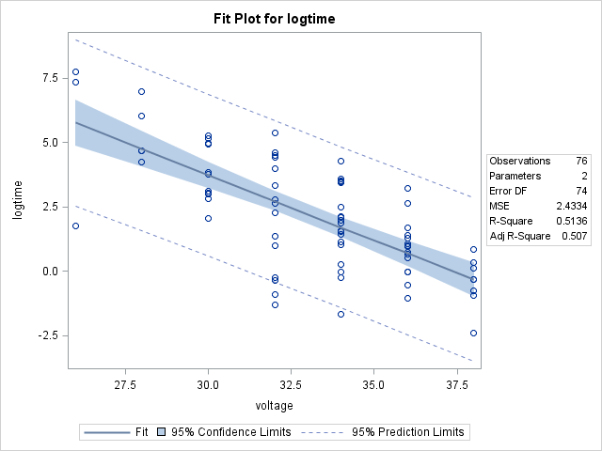
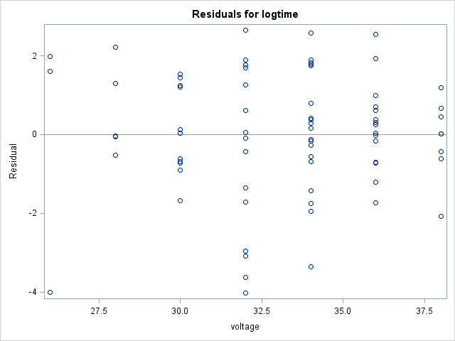
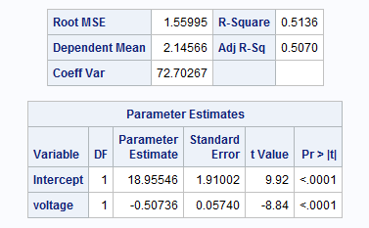
Try a Log-Linear Model
$$μ\left\{\log{(Insulation)} | Voltage\right\}=β_{0}+β_{1}Voltage$$
Variance looks more constant. What looks like smaller spread might just be fewer data points at those levels.
Linearity looks much better.

Slide 18

















Log Transforms: Log-Linear
$$μ\left\{\log\left(Y\right) | X\right\}=β_{0}+β_{1}\left(X\right)$$
*Assume $\log\left(Y\right)=\log_{e}{(Y)}$ here.
$$log⁡(Median\left(Y | X\right))=β_{0}+β_{1}(X)$$
*$\log\left(Median\left(Y\right)\right)=mean\left(\log\left(Y\right)\right)$
$$e^{log⁡(Median\left(Y | X\right))}=e^{β_{0}+β_{1}X}$$
*$a^{\log_{a}{y}}=y$ for any $a>0$
$$Median\left(Y | X\right)=e^{β_{0}}e^{β_{1}X}$$
and $Median\left(Y | X+1\right)=e^{β_{0}}e^{β_{1}(X+1)}$
$$Median\left(Y | X+1\right)/ Median\left(Y | X\right)$$
$${=e}^{β_{0}}e^{β_{1}(X+1)}/e^{β_{0}}e^{β_{1}X}$$
$$Median\left(Y | X+1\right)/ Median\left(Y | X\right)$$
$${=e}^{β_{1}(X+1)}/e^{β_{1}X}$$
$$Median\left(Y | X+1\right)/ Median\left(Y | X\right)$$
$$={ e}^{β_{1}X}e^{β_{1}}/e^{β_{1}X}$$
$$Median\left(Y | X+1\right)/ Median\left(Y | X\right)$$
$${=e}^{β_{1}}$$
Note: e = 2.718
(Approximately)
Interpretation: A one unit increase in X is associated with a multiplicative change of $e^{β_{1}}$ in Median(Y|X).
** Note: We use a base of e for $e^{β_{1}}$ because the base on the log function was implied to be e. (Other bases could be interchanged.)

Slide 19
Interpretation: Log – Linear
The data suggest each 1 kV increase in voltage is associated with a decrease in the median time to insulation breakdown by a factor of e^{-0.507 =} 0.6. That is, the median y at each value of x is only 0.6 of the median y at 1 less unit of x. In other words, a one unit increase in Voltage is associated with a 40% decrease in median time to breakdown.
A 95% confidence interval for $β_{1}$is
$$point estimate±multiplier∗standard error$$
${\hat{β}}_{1}±t_{.975, 76−2}∗SE({\hat{β}}_{1}$)
-0.507 $±$ 1.99*0.0574
-0.507 $±$ 0.1142
(-0.621, -0.393)
Therefore, a 95% confidence interval for the multiplicative decrease in median time is (e^{-0.621}, e^{-0.393}) = (0.54, 0.68) ~ (-46%, -32%).
It is estimated that voltage explains about 51.36% of the variation in breakdown time of this insulation fluid.

Slide 20
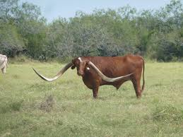
Meat Processing and pH
A certain kind of meat processing may begin once the pH in postmortem muscle of a steer carcass decreases to 6.0 from a pH at time of slaughter of around 7.0 to 7.2. It is not practical to monitor the pH decline for each animal. So, an estimate is needed of the time after slaughter at which the pH reaches 6.0. To estimate this time, 10 steer carcasses were assigned to be measured for pH at one of five times after slaughter.

Slide 21
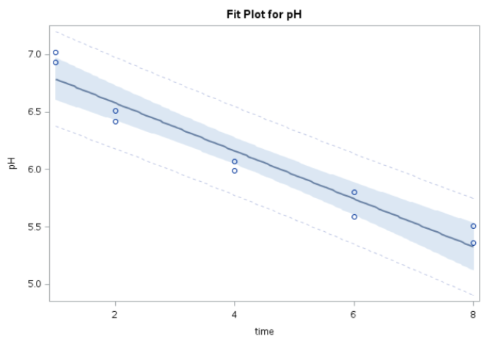
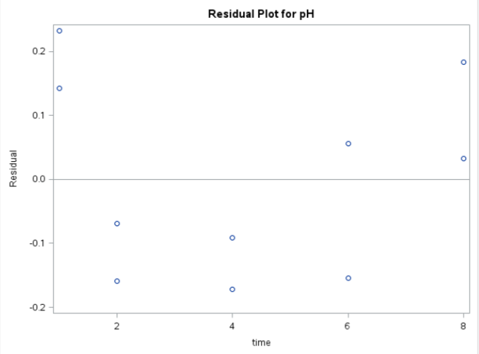

No Transforms: Linear
$$\hat{Y}=β_{0}+β_{1}⁡\left(X\right)$$
Curvature likely.

Slide 22
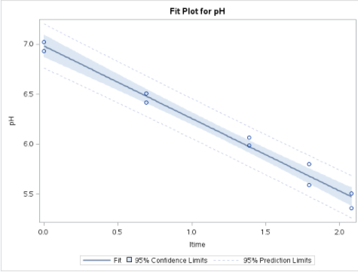
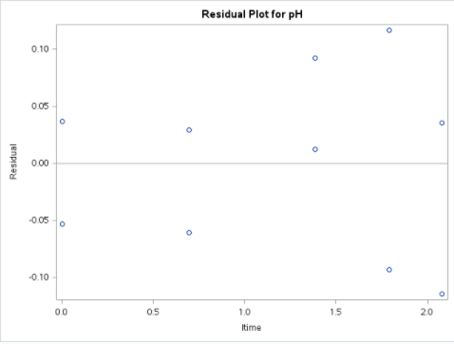
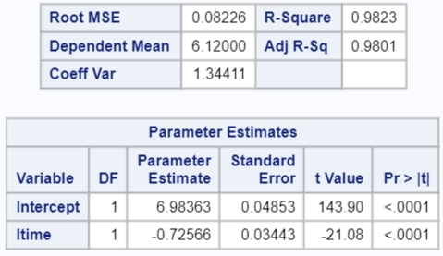

Log Transforms: Linear-Log
$$\hat{Y}=β_{0}+β_{1}\log\left(X\right)$$
Linearity much better.
Random cloud of residuals.

Slide 23




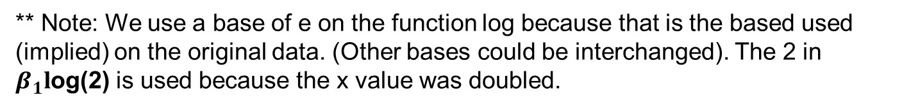

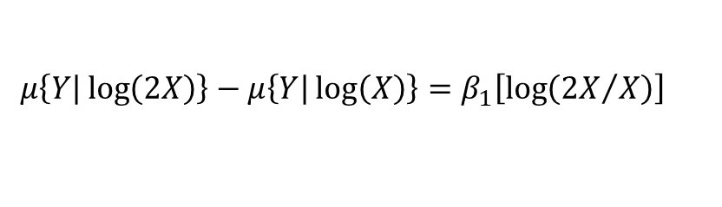

Log Transforms: Linear - Log
$$μ\left\{Y | \log\left(X\right)\right\}\text{=}β_{0}+β_{1}\log\left(X\right)$$
$$μ\left\{Y | \log\left(X\right)\right\}\text{=}β_{0}+β_{1}\log\left(X\right)$$
$$and$$
$$μ\left\{Y | \log\left(2X\right)\right\}\text{=}β_{0}+β_{1}\log\left(2X\right)$$
$$μ\left\{Y | \log\left(2X\right)\right\}−μ\left\{Y | \log\left(X\right)\right\}$$
$$=β_{0}+β_{1}\log\left(2X\right)−\left(β_{0}+β_{1}\log\left(X\right)\right)$$
$$μ\left\{Y | \log\left(2X\right)\right\}−μ\left\{Y | \log\left(X\right)\right\}=β_{1}\log\left(2X\right)−β_{1}\log\left(X\right)$$
$$μ\left\{Y | \log\left(2X\right)\right\}−μ\left\{Y | \log\left(X\right)\right\}=β_{1}\left[\log\left(2X\right)−\log\left(X\right)\right]$$
$$μ\left\{Y | \log\left(2X\right)\right\}−μ\left\{Y | \log\left(X\right)\right\}=β_{1}\left[\log\left({2X}/X\right)\right]$$
$$μ\left\{Y | \log\left(2X\right)\right\}−μ\left\{Y | \log\left(X\right)\right\}=β_{1}\log\left(2\right)$$
Interpretation: A doubling of X results in a $β_{1}l$og(2) unit change in the mean of Y.
** Note: We use a base of e on the function log because that is the based used (implied) on the original data. (Other bases could be interchanged). The 2 in $β_{1}l$og(2) is used because the x value was doubled.

Slide 24
Interpretation: Linear – Log
$$μ\left\{Y | \log\left(2X\right)\right\}−μ\left\{Y | \log\left(X\right)\right\}=β_{1}\log\left(2\right)$$
The data suggest that the predicted mean pH changes by (-0.7257)log(2) = -0.503 for each doubling of time.
A 95% confidence interval for $β_{1}$is
$$point estimate±multiplier∗standard error$$
${\hat{β}}_{1}±t_{.975, 10−2}∗SE({\hat{β}}_{1}$)
-0.7257 $±$ 2.31*0.03443
-0.7257 $±$ 0.0795
(-0.8052, -0.6462)
A 95% confidence interval for $β_{1}Log\left(2\right)$ (or for the change in mean pH for each doubling of time) is:
[-0.805log(2), -0.646log(2)] = (-0.558, -0.448).
It is estimated that time explains about 98.23% of the variation in pH of steer carcasses.

Slide 25
Example
U.S. Presidential Election: Nov. 7, 2000
It call came down to Florida.
Gore was projected to be the winner.
Then Bush was projected to be the winner.
Gore conceded.
Bush’s lead was cut to only 1,738 votes.
Gore retracts concession.
Automatic recount invoked.
Bush lead by less than 400 votes!
A strange phenomenon is discovered ….

Slide 26
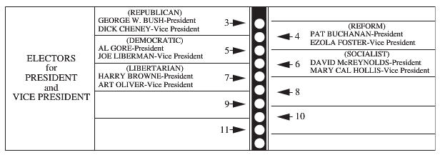
Palm Beach County
In this county, Buchanan had a suspiciously large number of votes.
On closer inspection, there was also a suspiciously large number of ballots that where thrown out because two “chads” were punched out. (Only 1 is allowed.)
Inspection of the ballot suggests some votes meant for Gore were actually cast for Buchanan. Also, some voters may have realized their error and then also punched the third dot, unknowingly invalidating the vote.
GOAL: Estimate how many of the votes for Buchanan were meant for Gore.

Slide 27
Strategy
Build a Prediction Interval for Buchanan for Palm Beach County.
We need a regression equation to calculate a prediction interval.
We will regress Buchanan Votes on Bush Votes from each county.
From the forthcoming prediction interval, we can estimate how many votes Buchanan should receive given the explanatory variable Bush Votes.
Simply Subtract the number of votes Buchanan Actually received from this predicted number.
Let’s Begin!

Slide 28
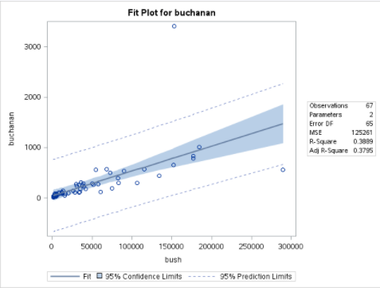
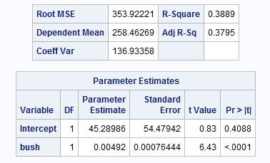
Scatterplot: Buchanan vs. Bush
Palm Beach
(152,846, 3,407)

Slide 29
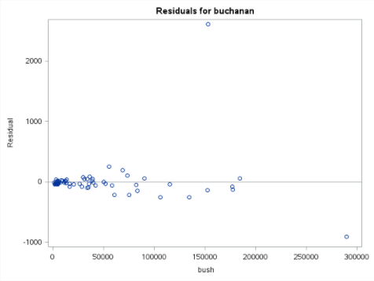
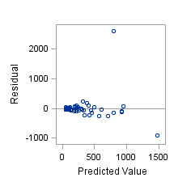
Residuals

Slide 30
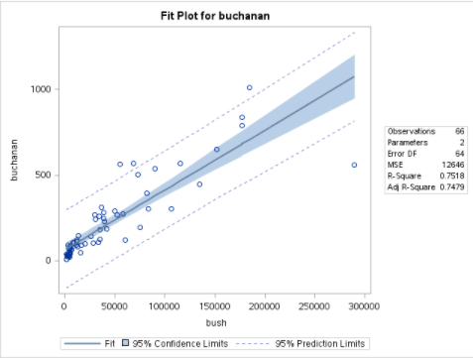
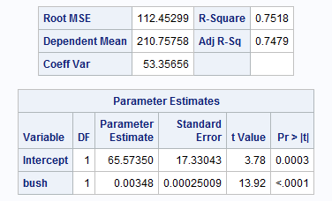
Without Palm Beach County
Full Data
Without Palm Beach
We will assume the Palm Beach County data is an error and proceed with the model without the outlier / without Palm Beach.

Slide 31
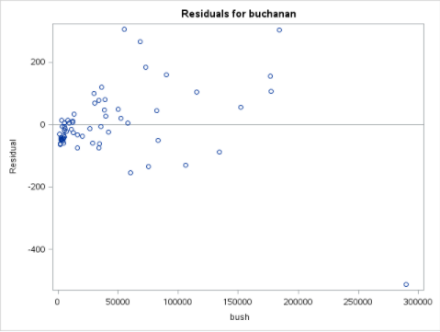
Residuals
Non-constant variance!

Slide 32
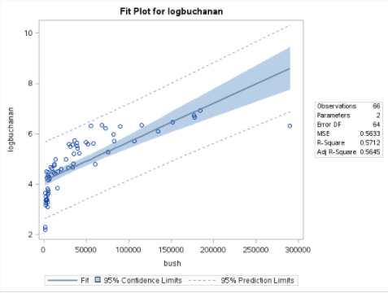
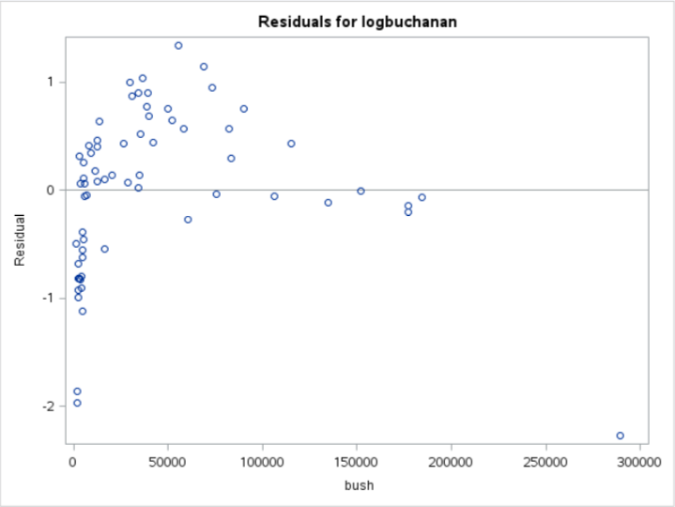
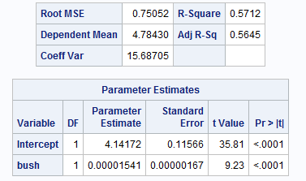
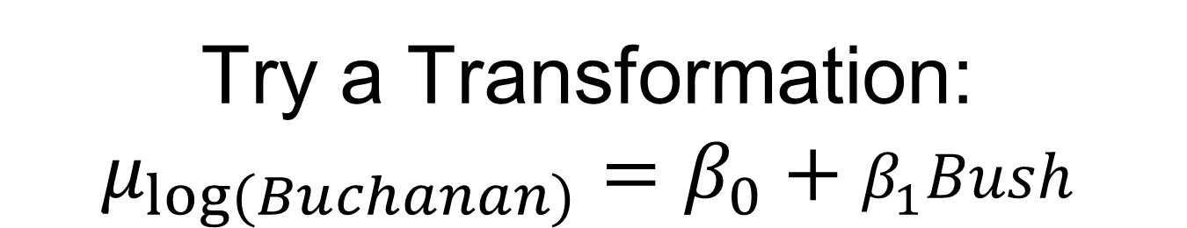
Try a Transformation: $$μ_{log⁡(Buchanan)}=β_{0}+β_{1}Bush$$
Log-linear transform didn’t fix the data!

Slide 33

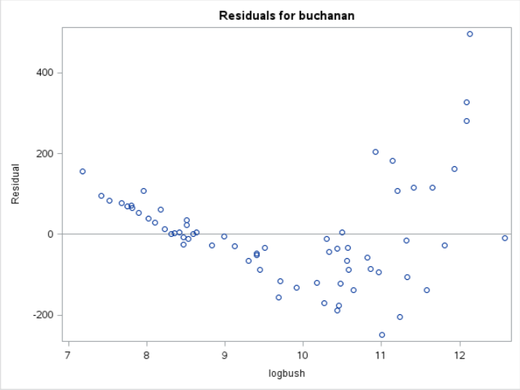
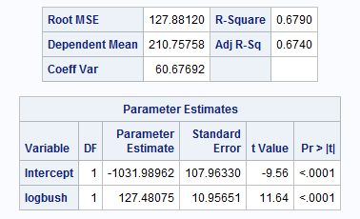

Try a Transformation: $$μ_{Buchanan}=β_{0}+β_{1}log⁡(Bush)$$
Linear-log transform didn’t fix the data!

Slide 34
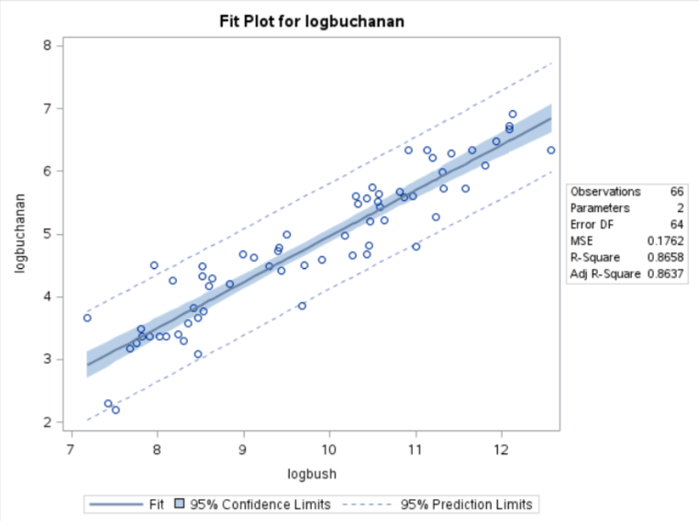
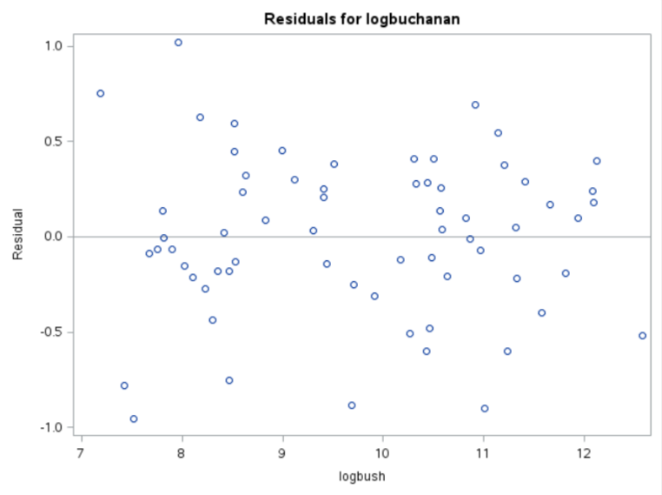
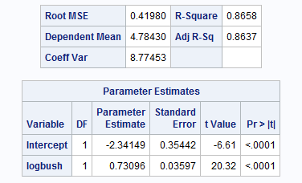

log Y and log X … $$μ_{log⁡(Buchanan)}=β_{0}+β_{1}log⁡(Bush)$$
Residuals are a random cloud with equal variances! Log-log transform, it is!

Slide 35

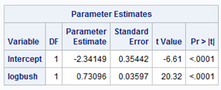
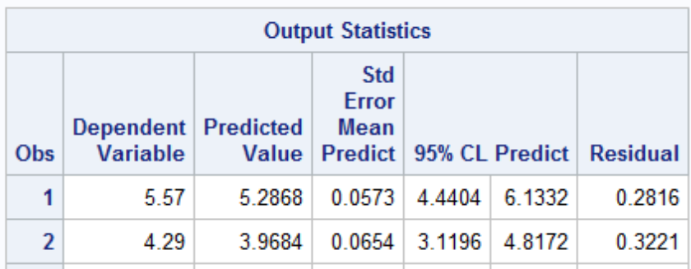
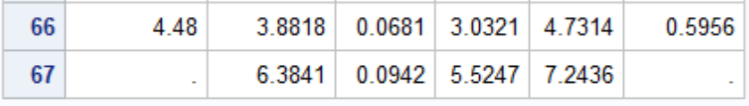



Interpretation
Bush votes in Palm Beach County: 152,846
$$Pred(\log\left(Buchanan\right))=−2.34+.731\log\left(Bush\right)$$
log(152,846) = 11.93
$$Pred(\log\left(Buchanan\right))=−2.34+.731\left(11.93\right)$$
$$Pred(\log\left(Buchanan\right))=6.38$$
e^{5.5247} = 251
e^{7.2436}= 1399
$$Pred(Buchanan)=e^{6.38}$$
$$Pred(Buchanan)=589.93$$
$$95\% Prediction Interval for Buchanan Votes at Bush Votes=152,846$$
$$is \left(251 votes, 1399 votes\right), with the best estimate of 590 votes.$$

Slide 36
Result!
$$95\% Prediction Interval for Buchanan Votes at Bush Votes=152,846$$
$$is \left(251 votes, 1399 votes\right).$$
The actual vote count for Buchanan was 3407, and the largest predicted (95% confidence) value was 1399.
Erring on the generous side, we can predict that 3407 – 1399 = 2008 votes were not meant for Buchanan.
If at least 400 of these were meant to be cast for Gore, the world could be a very, very different place!

Slide 37


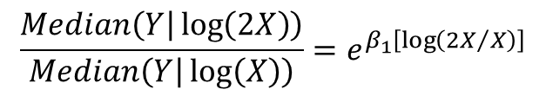










Interpretation Log-Log Model
$$μ\left\{\log\left(Y\right) | \log\left(X\right)\right\}=β_{0}+β_{1}\log\left(X\right)$$
$$\log\left(Median\left(Y | \log\left(X\right)\right)\right)=β_{0}+β_{1}\log\left(X\right)$$
*$\log\left(Median\left(Y\right)\right)=mean\left(\log\left(Y\right)\right)$
$$e^{\log\left(Median\left(Y | \log\left(X\right)\right)\right)}=e^{\left[β_{0}+β_{1}\log\left(X\right)\right]}$$
*$a^{\log_{a}{y}}=y$ for any $a>0$
$$Median\left(Y | \log\left(X\right)\right)=e^{\left[β_{0}+β_{1}\log\left(X\right)\right]}$$
and $Median\left(Y | \log\left(2X\right)\right)=e^{\left[β_{0}+β_{1}\log\left(2X\right)\right]}$
$$\frac{Median\left(Y | \log\left(2X\right)\right)}{Median\left(Y | \log\left(X\right)\right)}=\frac{e^{\left[β_{0}+β_{1}\log\left(2X\right)\right]}}{e^{\left[β_{0}+β_{1}\log\left(X\right)\right]}}=\frac{e^{β_{0}}e^{β_{1}\log\left(2X\right)}}{e^{β_{0}}e^{β_{1}\log\left(X\right)}}$$
$$\frac{Median\left(Y | \log\left(2X\right)\right)}{Median\left(Y | \log\left(X\right)\right)}=\frac{e^{β_{1}\log\left(2X\right)}}{e^{β_{1}\log\left(X\right)}}=e^{\left[β_{1}\log\left(2X\right)−β_{1}\log\left(X\right)\right]}$$
$$\frac{Median\left(Y | \log\left(2X\right)\right)}{Median\left(Y | \log\left(X\right)\right)}=e^{β_{1}\left[\log\left(2X\right)−\log\left(X\right)\right]}$$
** Note: We use a base of 2 for $2^{β_{1}}$ because the x value was doubled. Any base on the log could be used.
$$\frac{Median\left(Y | \log\left(2X\right)\right)}{Median\left(Y | \log\left(X\right)\right)}=e^{β_{1}\left[\log\left({2X}/X\right)\right]}$$
$$\frac{Median\left(Y | \log\left(2X\right)\right)}{Median\left(Y | \log\left(X\right)\right)}=e^{β_{1}\log\left(2\right)}=e^{\log\left(2^{β_{1}}\right)}$$
$$\frac{Median\left(Y | \log\left(2X\right)\right)}{Median\left(Y | \log\left(X\right)\right)}=2^{β_{1}}$$
Interpretation: A doubling of X is associated with a $2^{β_{1}}$ multiplicative increase in the median of Y. (This will be the case regardless of the base on the log function.)

Slide 38

Interpretation: Log – Log
$$\frac{Median\left(Y | \log\left(2X\right)\right)}{Median\left(Y | \log\left(X\right)\right)}=2^{β_{1}}$$
Therefore, a doubling of the votes for Bush equates to multiplicative change of 2^{0.731} = 1.66 in the median of the distribution of Buchanan votes for the given Bush tally. In other words, a doubling of votes for Bush increases the estimated median of Buchanan’s votes 66%.
A 95% confidence interval for $β_{1}$is
$$point estimate±multiplier∗standard error$$
${\hat{β}}_{1}±t_{.975, 66−2}∗SE({\hat{β}}_{1}$)
0.73096 $±$ 2.00*0.03597
0.73096 $±$ 0.07194
(0.659, 0.803)
Therefore, a 95% confidence interval for the multiplicative increase in median of Buchanan votes after a doubling of Bush votes is (2^{0.659}, 2^{0.803})=(1.58, 1.74) = (58%, 74%) increase.
It is estimated that the number of Bush votes explains about 86.58% of the variation in the number of votes Buchanan receives.

Slide 39



Summary:
Log-Linear Model:
Interpretation: A one unit increase in X is associated with a multiplicative change of $e^{β_{1}}$ in median of Y|X.
Linear-Log Model:
Interpretation: A doubling of X results in a $β_{1}$Log(2) unit change in the mean of Y|X.
Log-Log Model:
Interpretation: A doubling of X is associated with a $2^{β_{1}}$ multiplicative change in the median of Y|X.

